Slide 1

Not on My Network, You Don’t!
May I Try This?
Collaboration to Enhance
IT Teaching/Learning Environment
Session ID: 3084
Tues May 28, 13, 2:15-3:00
Room 13A, Level 4

Slide 2
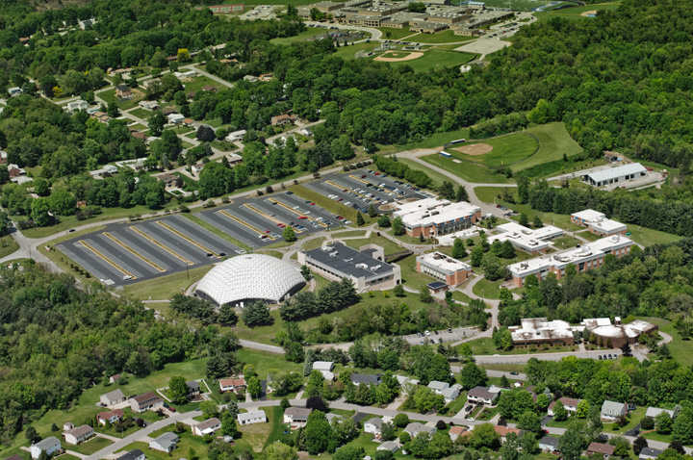
Founded in 1967
Center Township Campus
Aviation Sciences Center
Casino Training Center
Serves the 54 communities, 13 school districts, and 173,000 residents of Beaver County, Pennsylvania
Sponsored by the Board of Beaver County Commissioners

Slide 3
Presenters
Carl Dennis
Heidie Ganjineh Hutchinson
Walter Lukhaup
Community College of Beaver County
IT Faculty and IT Vice President

Slide 4
Cyber Security: Carl – Assistant Professor
      Cloud Computing, Virtualization
Web Programming: Heidie – Associate Professor
      Visual Programming, Web Programming
Campus Technology: Walter – VP IT
      Infrastructure, Hardware/Software

Slide 5
Not on My Network, You Don’t!
May I Try This?
Challenges Teaching IT Courses
Look for Solution
Cooperation/Collaboration to Develop a Realistic Solution
Implementation of the Solution
Evaluation of the Solution
  Increase in Students’ Interest
  Demonstrate Students’ Projects
Impact of the Solution

Slide 6
Web Programming Curriculum
2006 - 2011
Challenges Teaching IT Courses:
  No Windows Server Labs
  No Unix/Linux Server Labs
  No Dedicated Lab(s) for Web Programming
  Deep Freeze

Slide 7
Web Programming Curriculum
2006 - 2011
What are the Options?
  Look for Free Websites
Problems with Free Website:
  Lots of Popup Ads
  Not Reliable
    Every Day Chance of Going Out of Business
    Loss of Data
    Loss of Code

Slide 8
Web Programming Curriculum
2012
Look for a Realistic Solution
  Talk to other IT Faculty Directly and Ask for Help
  Talk to the New VP for IT and Ask for Help
  Talk to Web Programming Advisory Committee

Slide 9
Web Programming Curriculum
2012
Amazing!!!
  The VP for IT is Actually Interested in the Classroom Technology
  A Web Programming Advisory Committee Member Recommends Giving Each Student His/Her Own Server
  One IT Faculty is Willing to Experiment and Configure an External Server

Slide 10
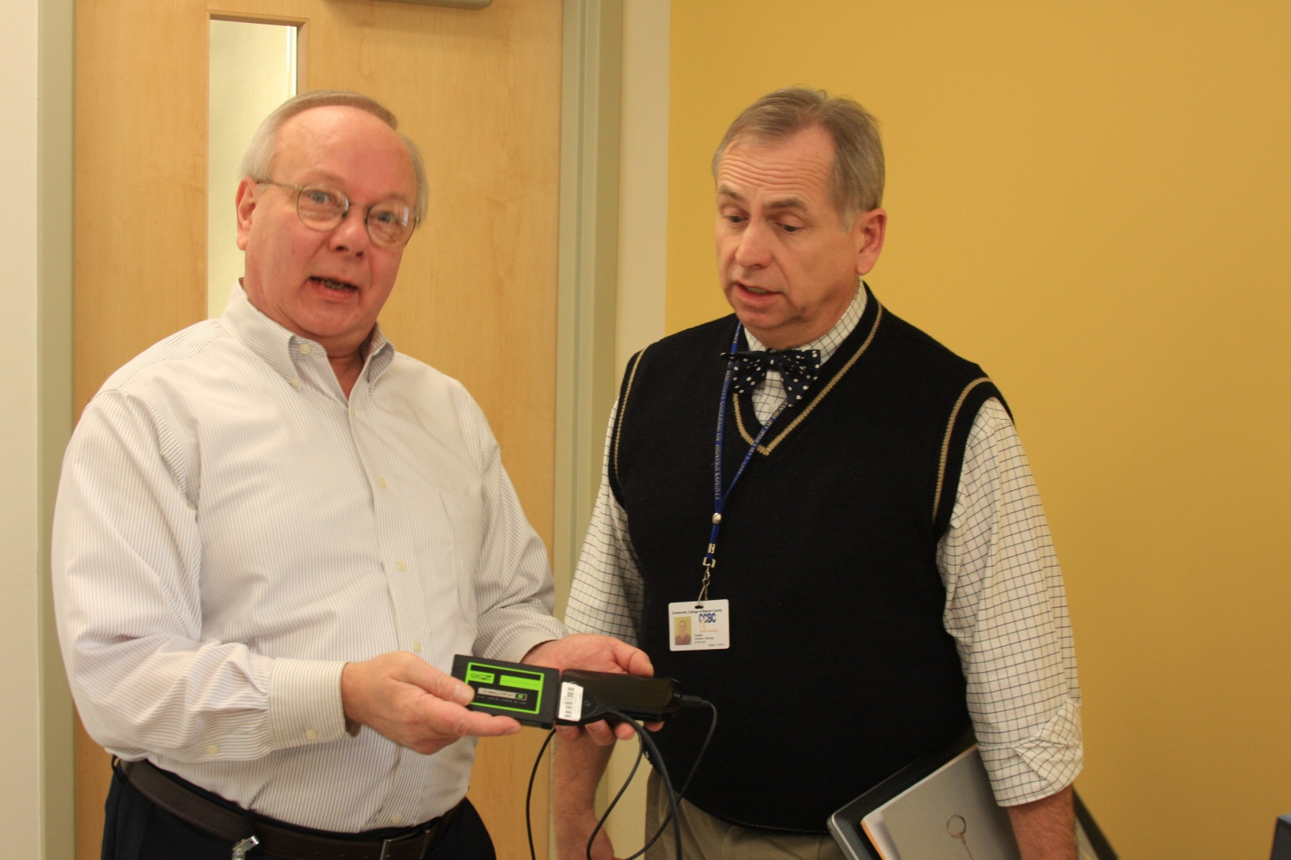
CCBC External Linux Server!! 2012

Slide 11
CCBC External Linux Server
2012
1 Terabyte External Hard Drive
Ubuntu 12.04.2 installed as the Operating System
Contains LAMP Stack
  Linux (Operating System)
  Apache (Web Sever)
  MySql (Data Base)
  PHP (Scripting Language of the Web)

Slide 12
CCBC External Linux Server
A Teaching/Learning Tool
You Can Teach Networking/Internet Concepts!!!
  Wireless Networks
  Wired Networks
  IP Addressing
  MAC Address
  Admin verses User Accounts
  Web Servers

Slide 13
CCBC External Linux Server
A Teaching/Learning Tool
You Can Teach Real Web Application Development!!!
  Client Applications
  Server Applications
  Necessary CGI for Connectivity Between Client and Server Apps
  Use of Hyper Texts
  Databases

Slide 14
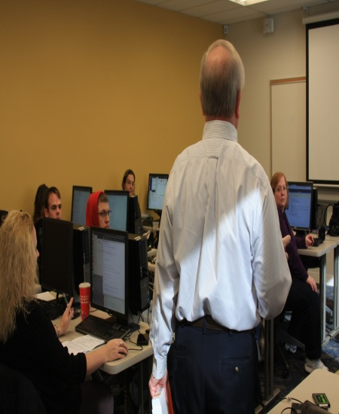
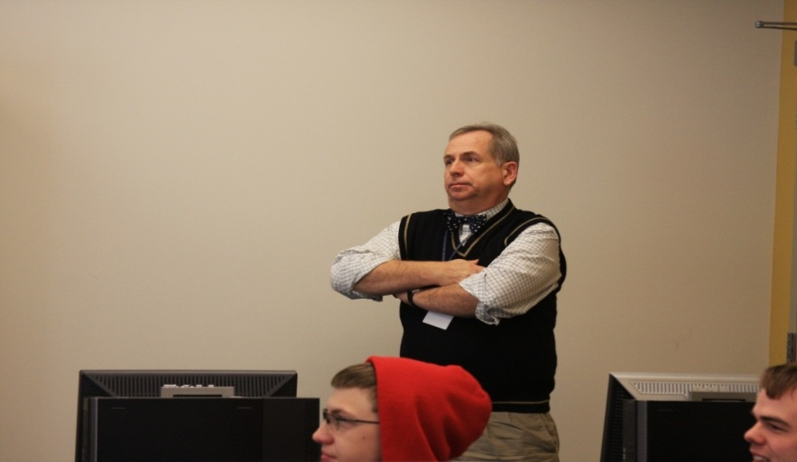

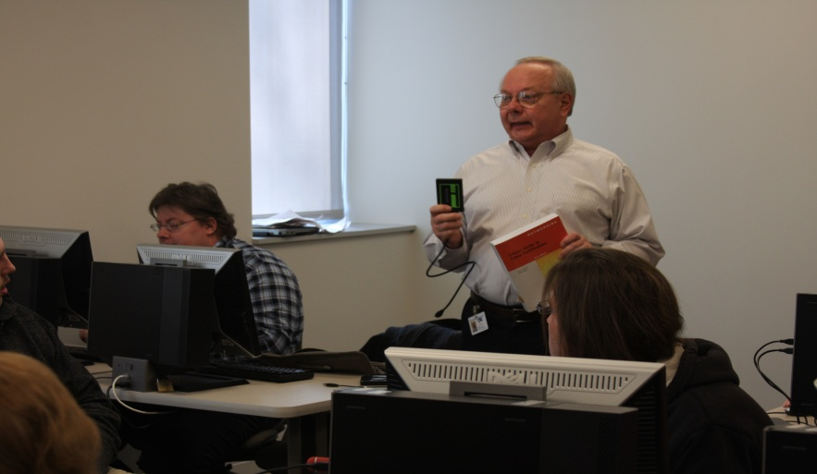
CISW101 Web Scripting Languages – Fall 2012

Slide 15
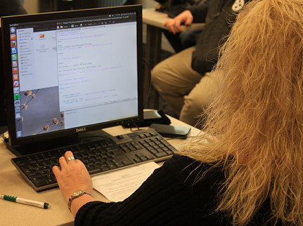
CISW101 Web Scripting Languages – Fall 2012

Slide 16
CISW101 Web Scripting Languages - Fall 2012
Increase in Students’ Success Rate:
  Fall 2012: 85.74
  Fall 2011: 47.05
  Fall 2010: 68.22
More Perfect Attendance:
  Fall 2012: 78.57%
  Fall 2011: 35.29%
  Fall 2010: 31.57%

Slide 17
CISW101 Web Scripting Languages - Fall 2012
Students Researched to Find Solutions for Linux Configuration Problems
Students Researched and Found Online Tutorial and Reference Websites for HTML, JavaScript, PHP
More Advance Topics Were Taught in the Class

Slide 18
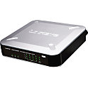
CCBC Wireless Network at NISOD
192.168.1.4
192.168.1.2
ccbcnisod
Router
192.168.1.1
192.168.1.5
192.168.1.3

Slide 19
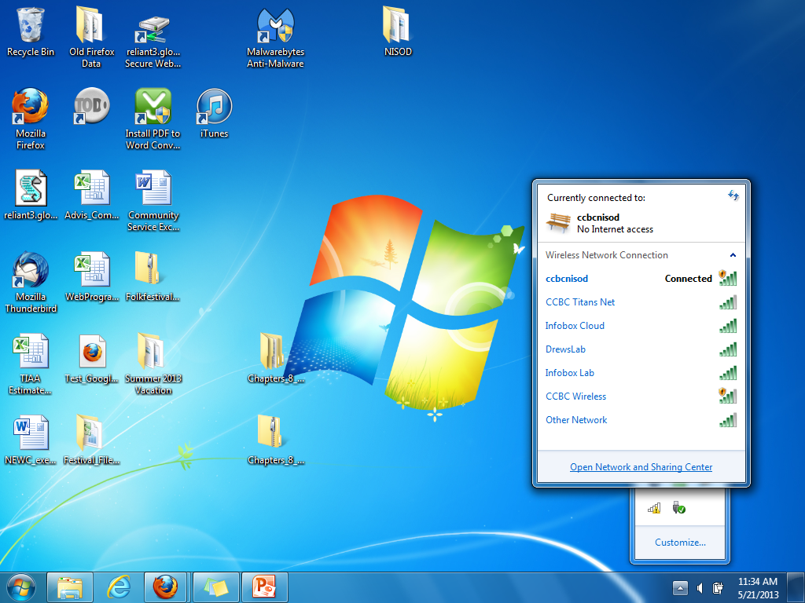
CCBC Wireless Network at NISOD

Slide 20
CISW101 Web Scripting Languages
Students’ Final Projects
Hillary Shames: 192.168.1.2
  Phi Calculator, Tiger, Rock/Paper/Scissors Game, Server Information (HTML 5, JavaScript, PHP)
Chris Knouff : 192.168.1.2
  Age Comparison (Client/Server – PHP)
Gary Cole: 192.168.1.3
  Number Guessing Game (JavaScript)
Michael Hertweck : 192.168.1.4
  Shopping List (Client/Server - PHP)

Slide 21
Revised Web Programming Curriculum 2013
New Web Programming Curriculum Highlights
Web Programming curriculum provides students with theoretical and hands-on experience in:
  Software Application Tools
  Web Programming Languages
  Database Management Systems
  Website Design and Development
  E-Commerce Applications

Slide 22
Revised Web Programming Curriculum 2013
First Semester
CIST100 Intro to IT
CISW101 Web Scripting Languages
CIST160 Visual Basic
VISC115 Digital Imaging
WRIT101 English Comp I
Second Semester
CISN200 Client OS
CIST106 Software
Productivity Tools
CISW205 Program in C#
CISW206 Web Data
Connectivity using
ASP and PHP
LITR210 Concepts of Lit
Or WRIT103 Writing for
Business and Tech

Slide 23
Revised Web Programming Curriculum 2013
Third Semester
CISN205 Server OS
Or
CISN203 Linux OS
CIST170 Website
Development
CISW201 Java I
MATH110 Business Math
Or Science Elective
CISW214 Database: SQL
and Crystal Report
Fourth Semester
CISW217 Mobile App.
Development
CISW202 Java II
CISW210 E-Commerce Applications
SOCI101 Principles of
Sociology
Or PSYC101 General Psych
CIST260 Internship
Or VISC122 Web Design

Slide 24
New Linux Server and Benefited Curricula
Web Programming Degree
Web Programming Certificate
Visual Communications: Web Design Degree
Visual Communications: Web Design Certificate
Networking Degree
Networking Certificate
Cyber Security Degree
Computer Support Specialist Certificate

Slide 25

Presenters’
Contact Information
Carl Dennis
Assistant Professor
CIS/Telecom: Cyber Security
724-480-3550
carl.dennis@ccbc.edu
Heidie G. Hutchinson
Associate Professor
CIS/Telecom: Web Programming
724-480-3547
heidie.Hutchinson.@ccbc.edu
Walter Lukhaup
Vice President Information Technology
724-480-3376
walter.lukhaup@ccbc.edu

